Slide 1

IAESTE
International Association for the Exchange of Students for Technical Experience

Slide 2
Welcome to IAESTE Work. Experience. Discover.
Volunteering with IAESTE can be a rewarding experience.
You can develop new skills, organizational, managerial, financial, social, and most importantly, you can make new friends and be a part of something special.
Although volunteering for IAESTE doesn’t guarantee you an internship, it certainly doesn’t hurt!

Slide 3
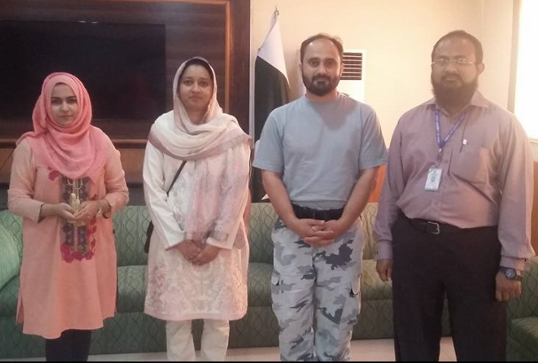
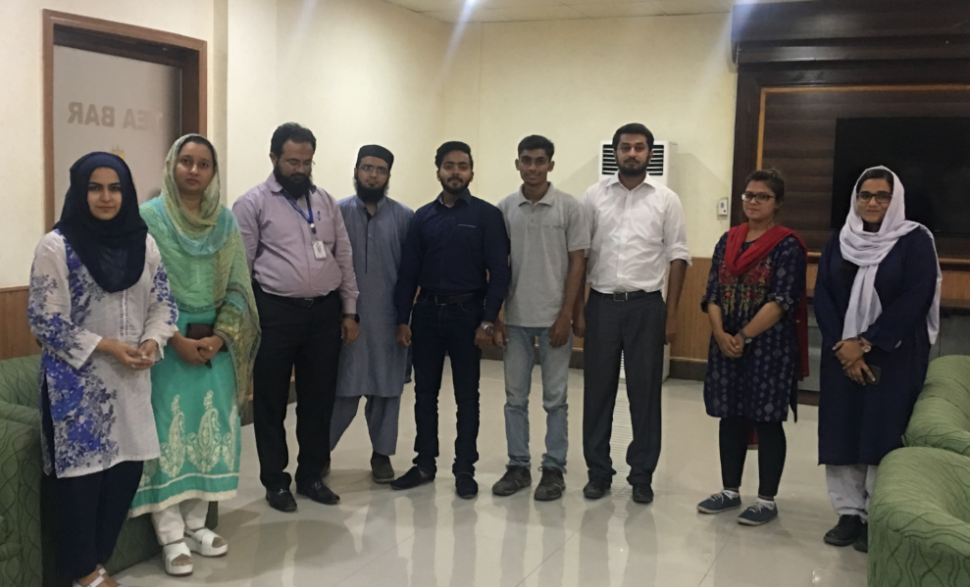
Truth vs.Falsity 2+2 = 4 1+1 =11

Slide 4
Facts
The International Association for the Exchange of Students for Technical Experience
88 offices in 82 countries
330 436 Trainee exchanges have taken place
5,000 traineeship places per year on average
3726 participating companies (‘09)
905 participating Educational institutions (‘09)
62 Annual conferences, 24 SID,15 JUMP
65 years of existence

Slide 5
Outline
Aims
History
Stucture
Positions and People
The Conferences – GC+Exchange
Guidelines for applicants
Perks for Members

Slide 6
The Aims of IAESTE
To provide students in higher education with technical experience relevant to their studies
To offer employers well-qualified and motivated trainees
To be a source of cultural enrichment for trainees and their host communities

Slide 7
History

Slide 8
History The beginning
Founded 1948 – 10 Western European countries
Developing and Exchanging for >60 years
Now 87 members & co-operating Institution from 83 countries
Average 5,000 trainees per year

Slide 9
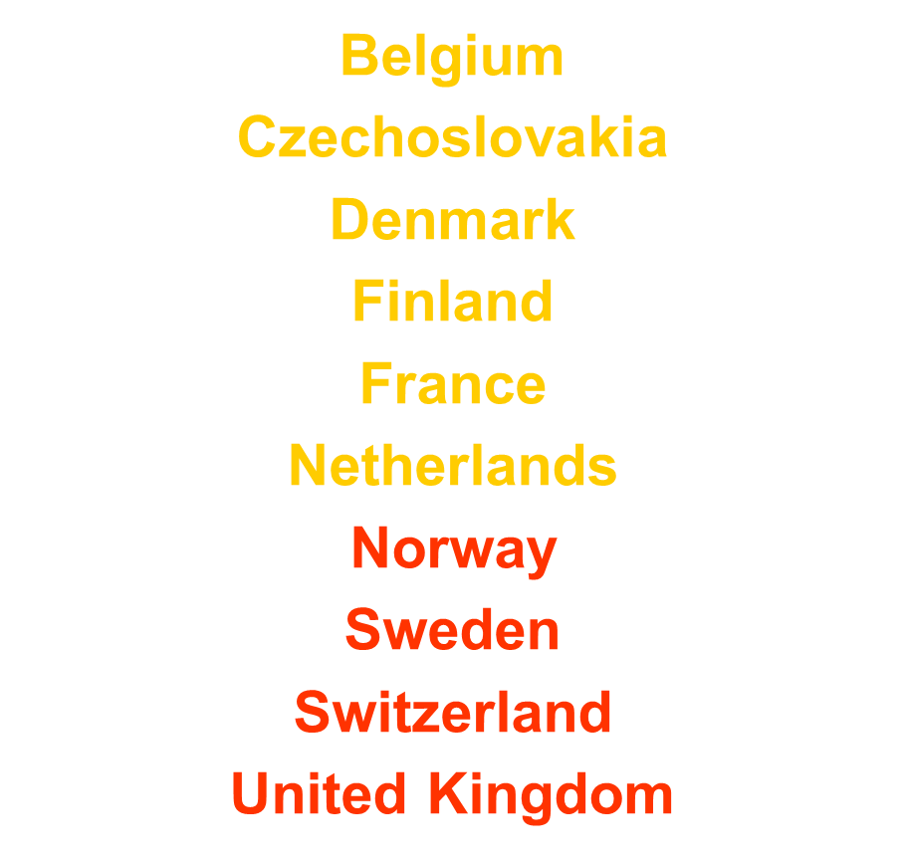
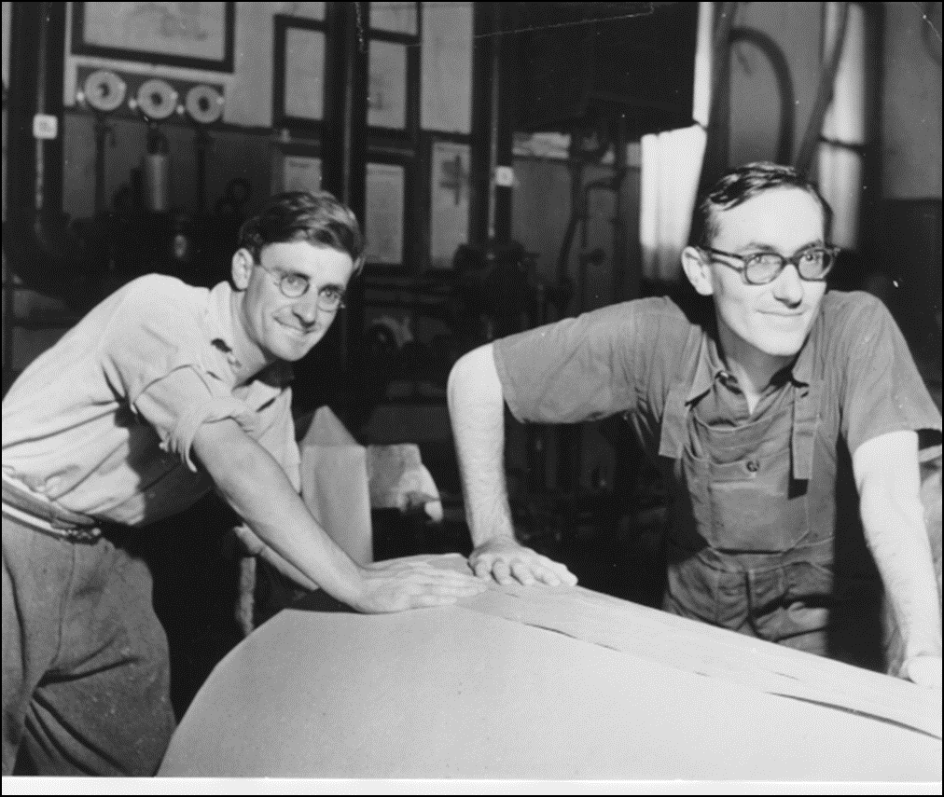
History Founding Members

Slide 10
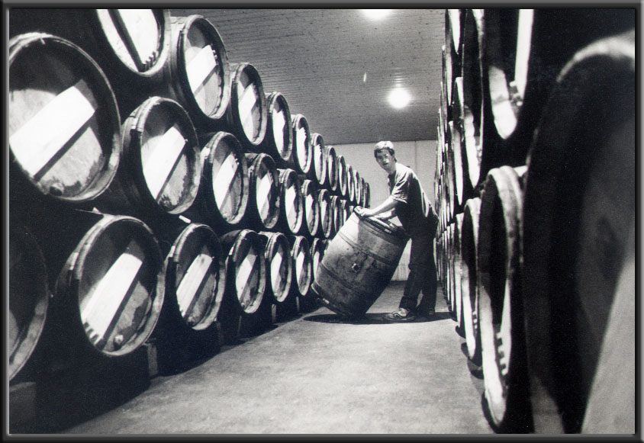
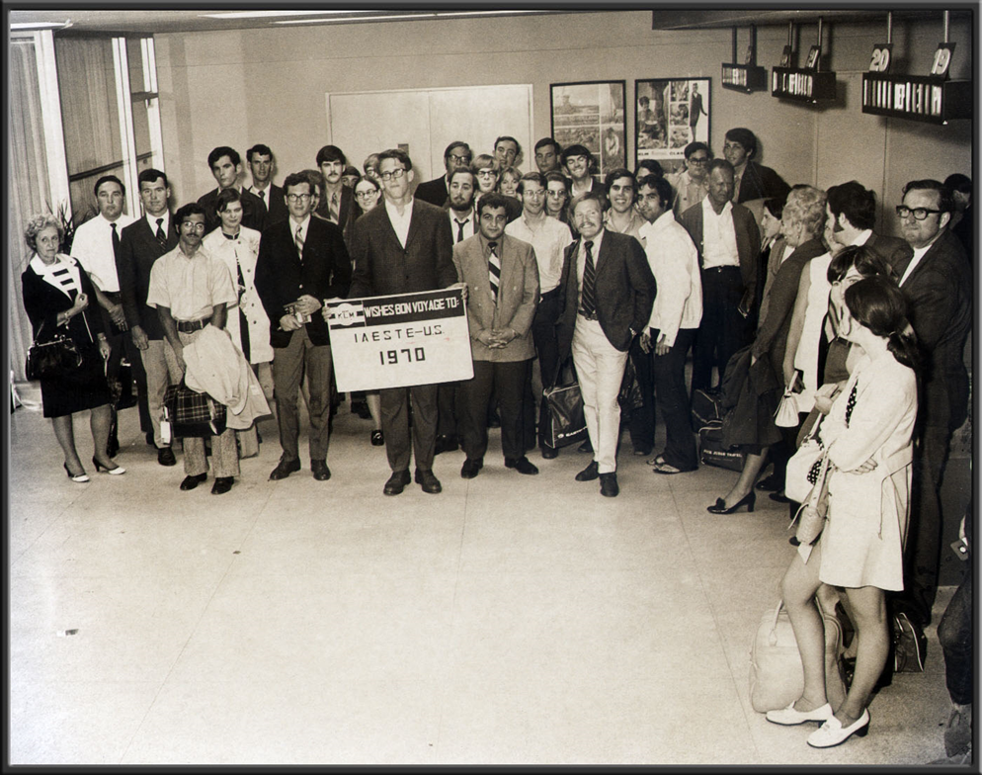
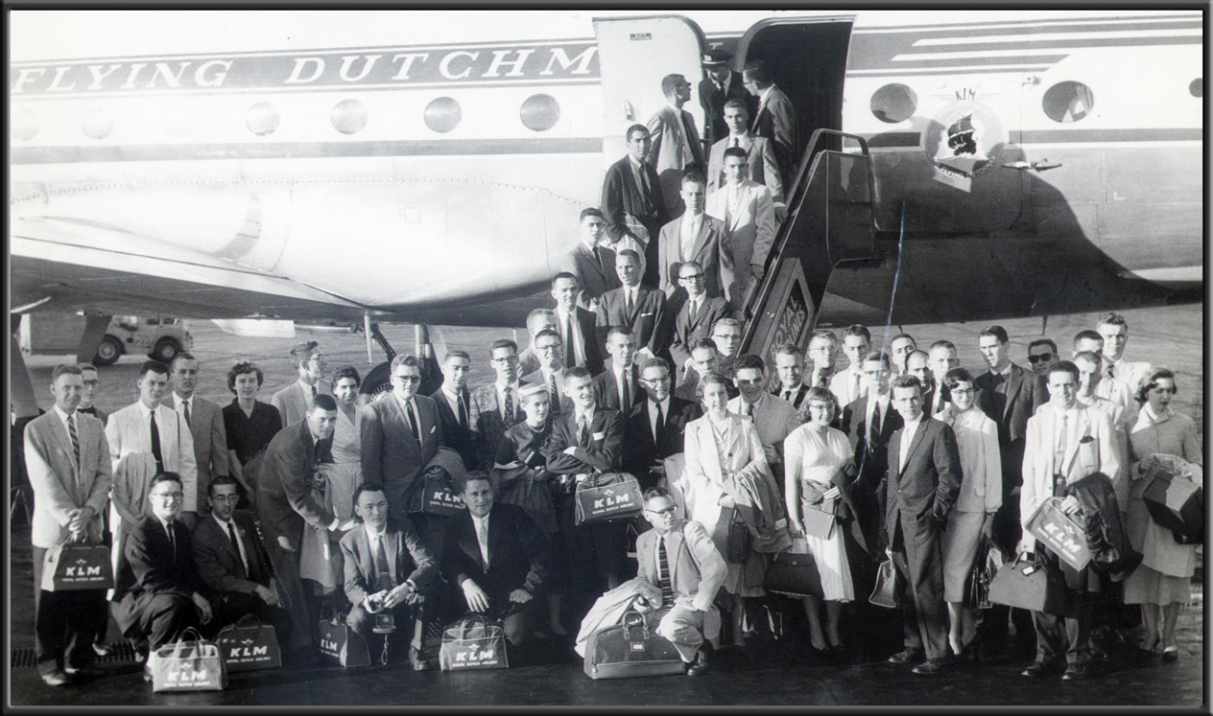
History …in pictures

Slide 11
Structure

Slide 12
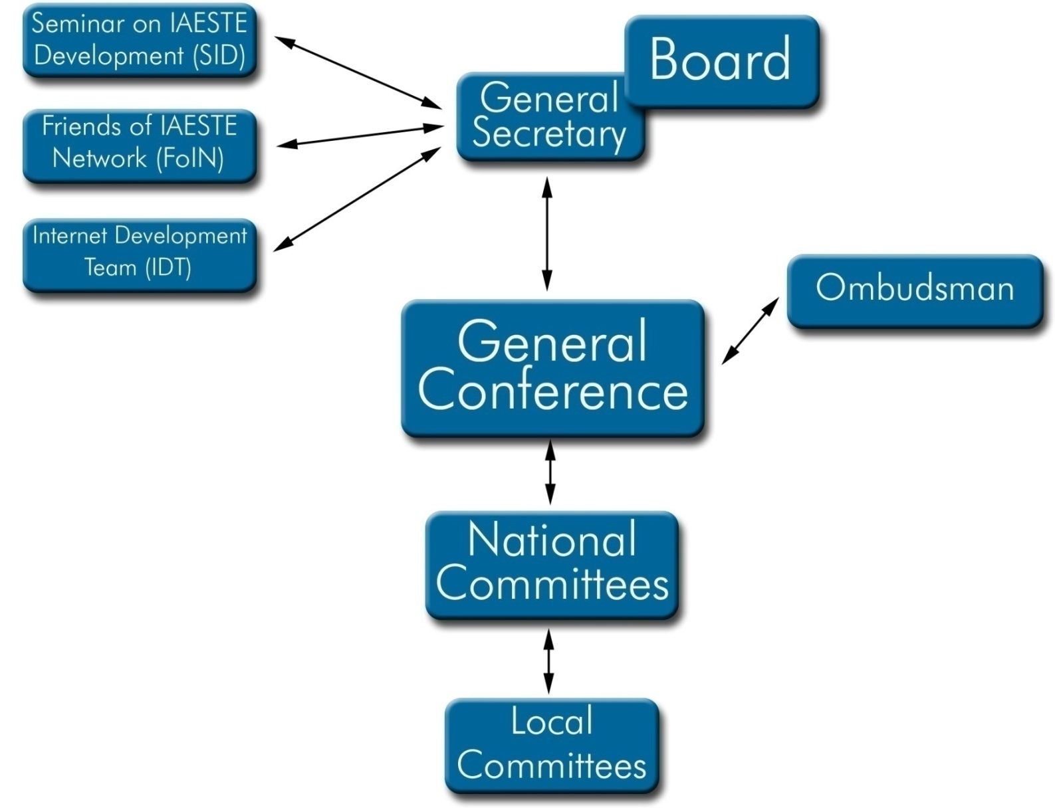
STRUCTURE

Slide 13
The Core of IAESTE
THE IAESTE is a confederation of National Committees representing academic, industrial and student interest.
Each National Committee is responsible for the administration of the exchange in its own country.
Each National Committee must have at least one permanent person responsible (National Secretary) for the day to day business

Slide 14
Division of labor between permanent and voluntary staff on national scale
- National Committee: mixture of “professionals and volunteers”
- National Office/ Secretariat: Permanent staff
- Local committees: volunteers
(Established at SEECS on 08-03-2010)
Each country has to find its suitable mixture/formula, which is efficient for its domestic situation and compatible with the international superstructure

Slide 15
The Core of IAESTE TASKS OF LOCAL COMMITTEES (LC)
One of the aims of IAESTE is the promoting of international understanding and goodwill. Organizing a social program for incoming trainees contributes greatly to this end. A variety of activities are set up by LC´s:
- weekly meetings.
- weekend get-togethers: Movies, hiking
- company visits
- sightseeing trips to other parts of the country or into neighbor countries

Slide 16
A model with an important role for the Local Committees
Global Structure of IAESTE in Germany
IAESTE National Organization (National Committee)
German Academic Exchange Service DAAD
National Secretary
78 International Students Offices who take care of IAESTE matters
13 Joint IAESTE-/ AIESEC -LC
4 AIESEC LC who take care of IAESTE students
Staff 7 Persons
33 IAESTE-LC

Slide 17
LC STRUCTURE MACEDONIA
LC President
Incoming
Summer Reception Coordinator
Marketing
Members recruitment coordinator
Outgoing
Finances
IT coordinator
Job Raising coordinator
Volunteers
Volunteers
Volunteers

Slide 18
The
Conference

Slide 19
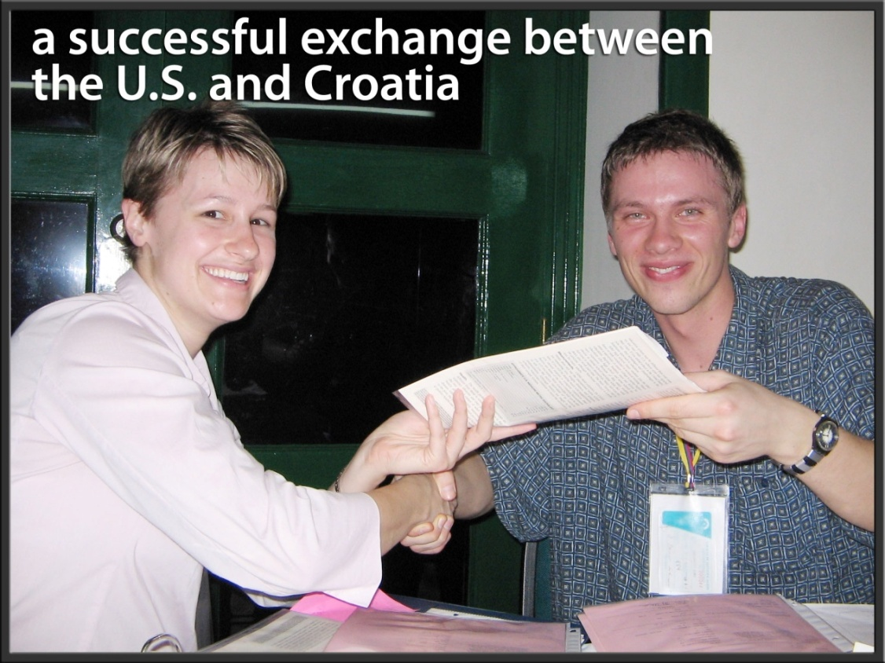
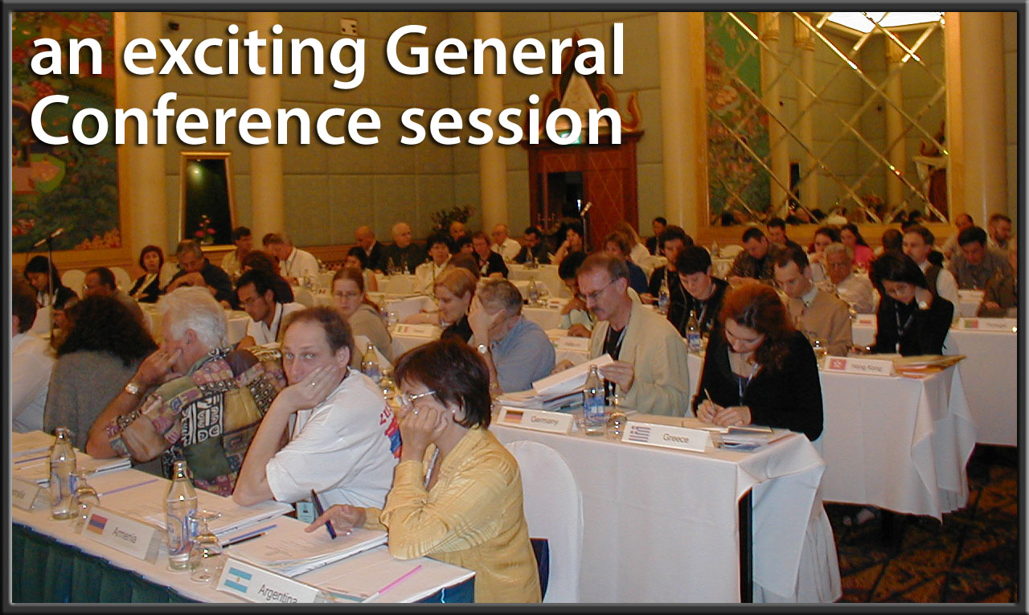
The Conference 2011
Two in One – GC + Exchange
General Conference
Official delegates vote on IAESTE policies
Exchange Conference
Traineeship offers are exchanged between Members and Co-operating Institutions

Slide 20
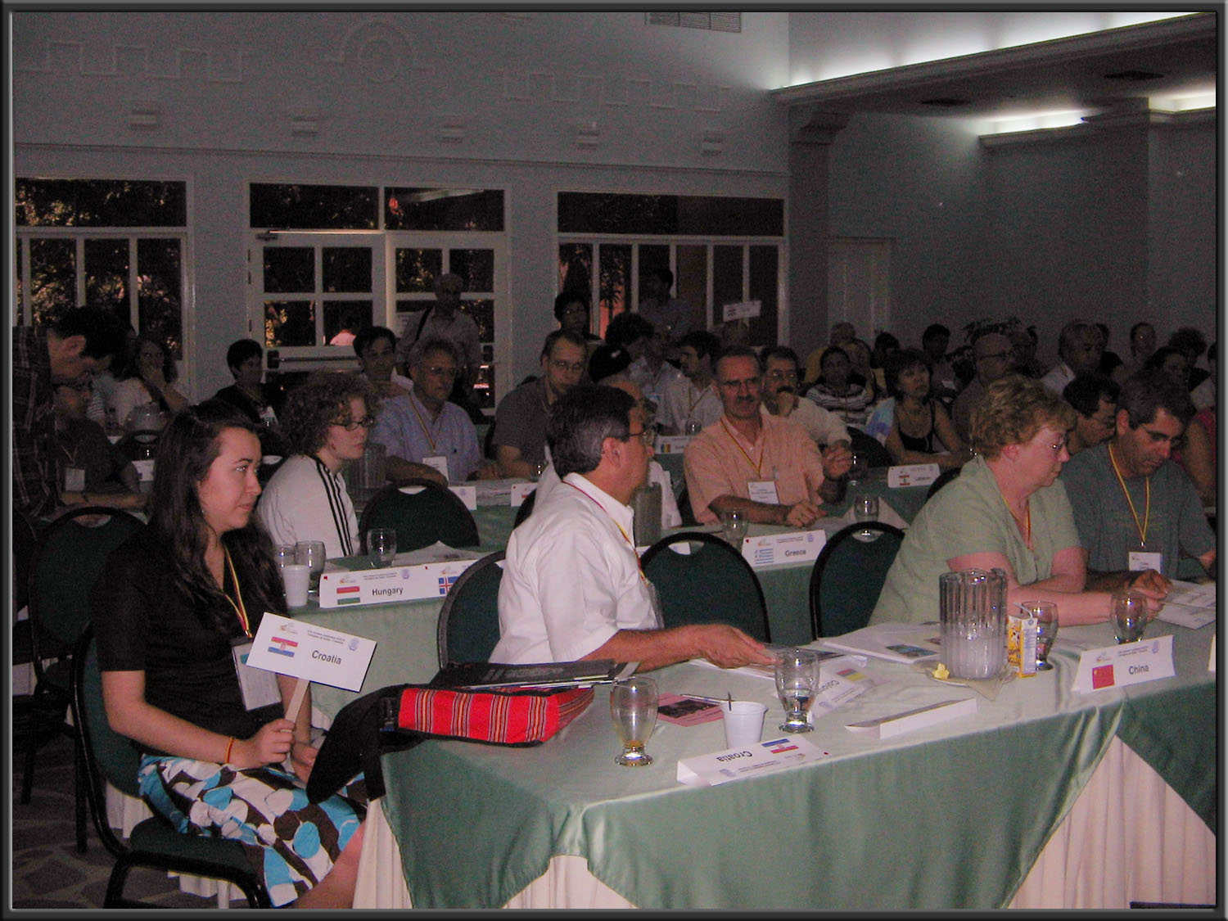
The General Conference
“The purpose of the General Conference is to offer an opportunity for the General Assembly (one representative from each country) to meet, discuss and
vote on matters concerning IAESTE’s activities.”
--Annual Conference Delegate Guide

Slide 21
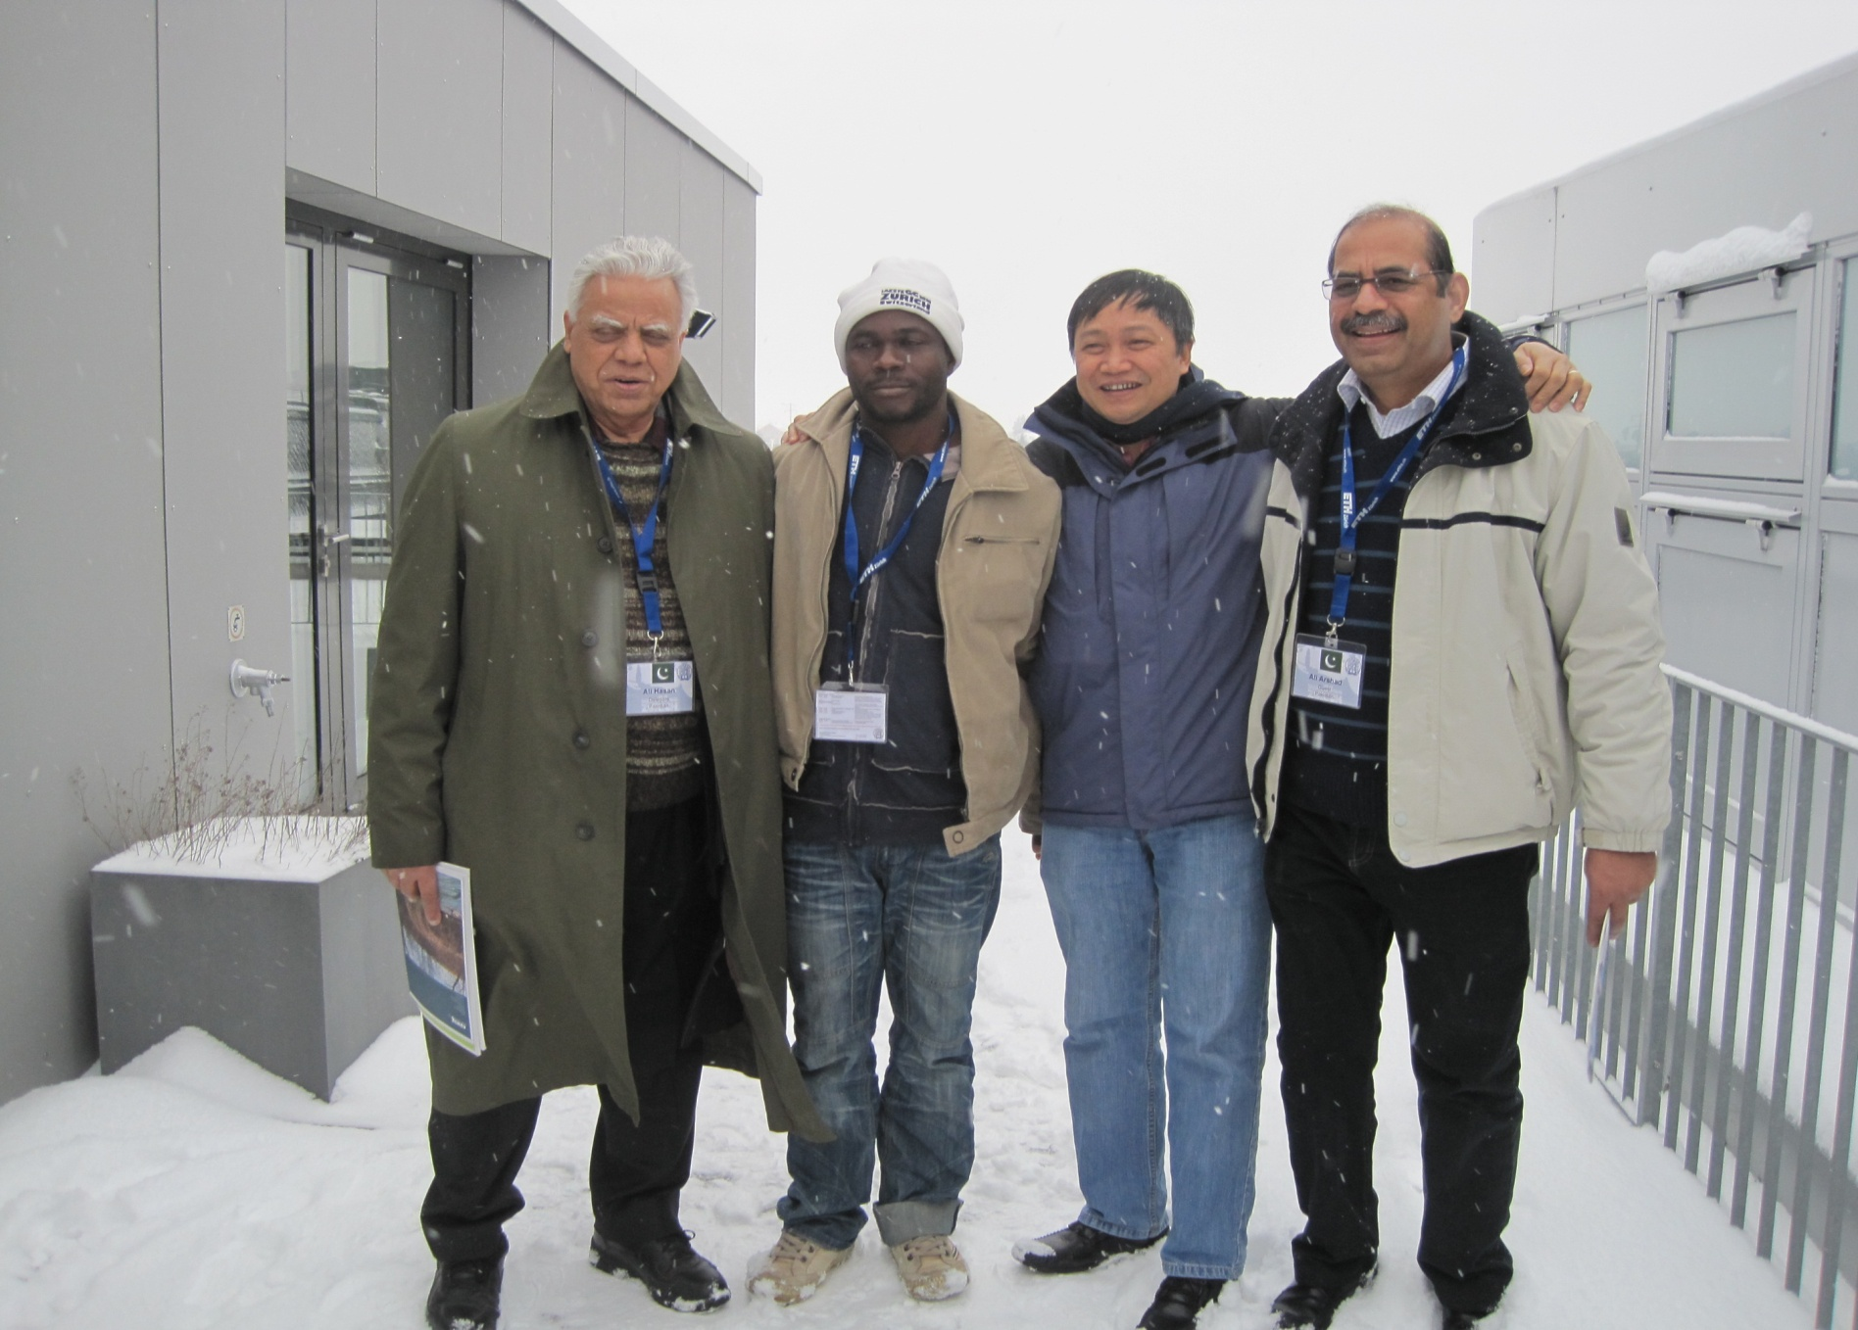

Slide 22
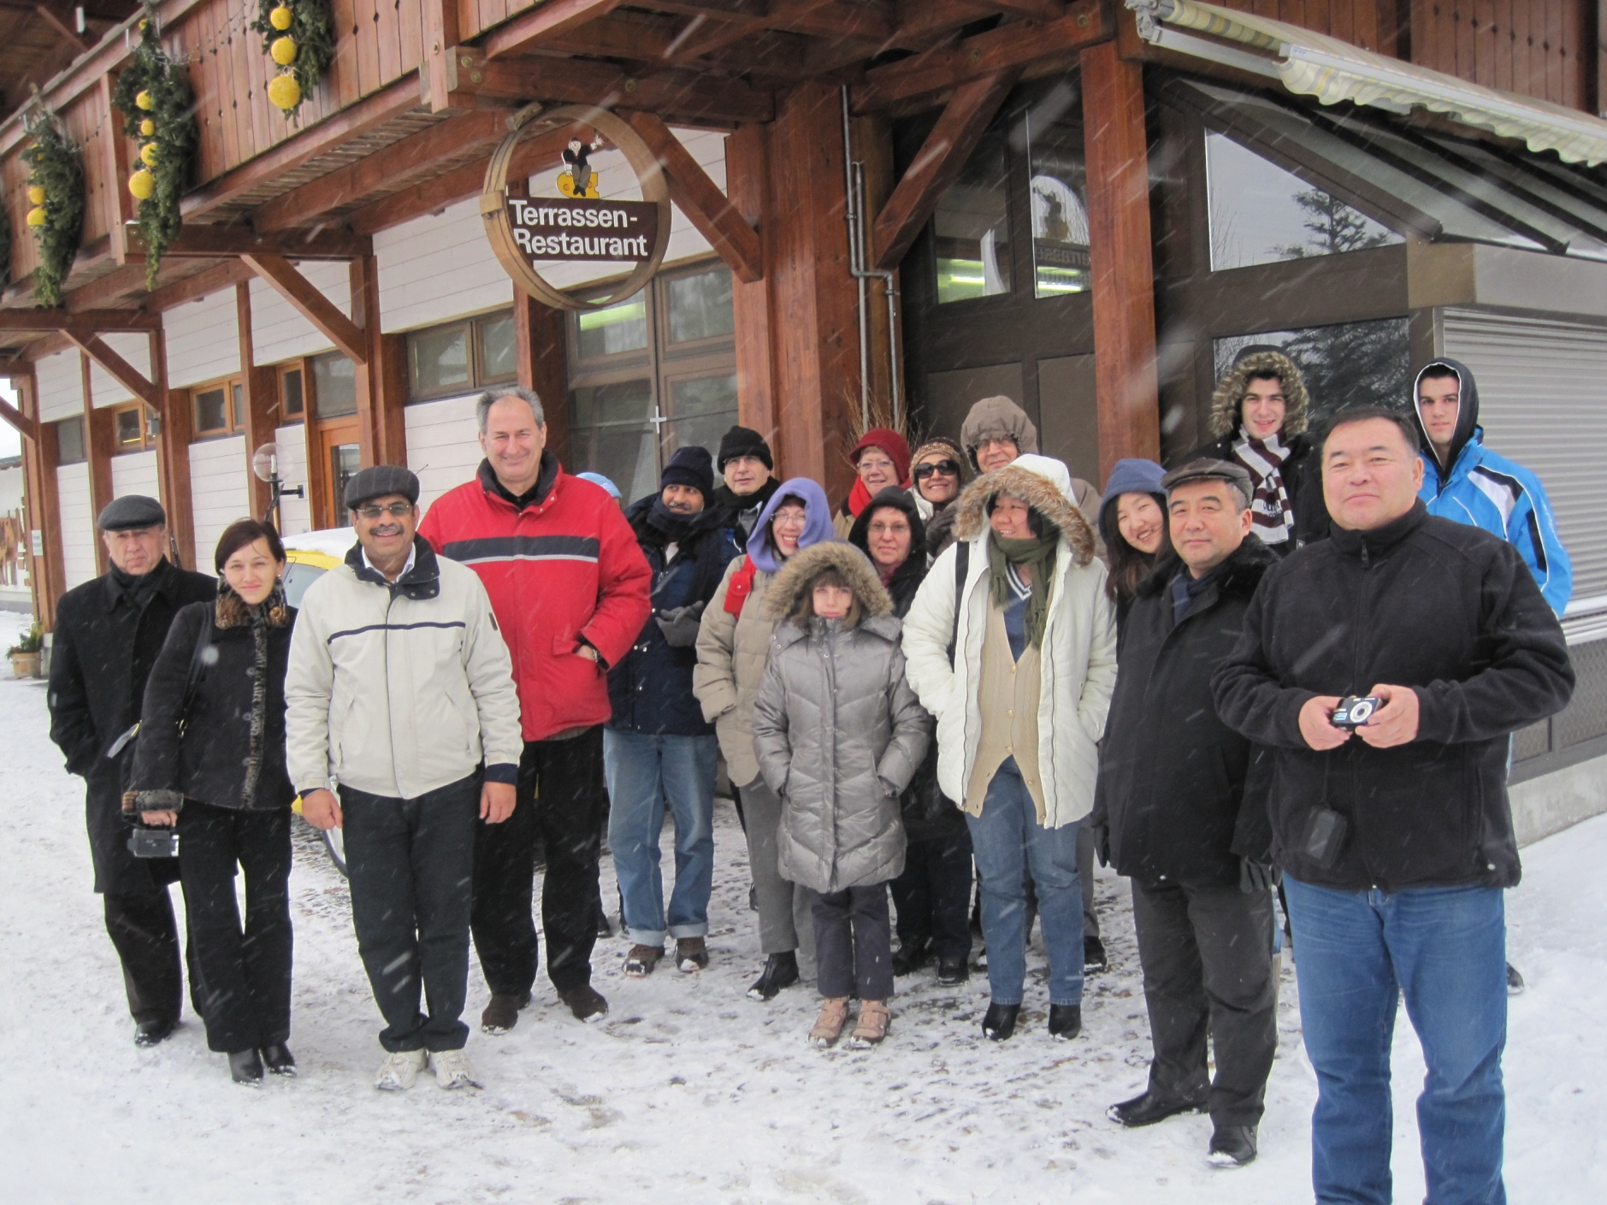

Slide 23
The
Exchange

Slide 24
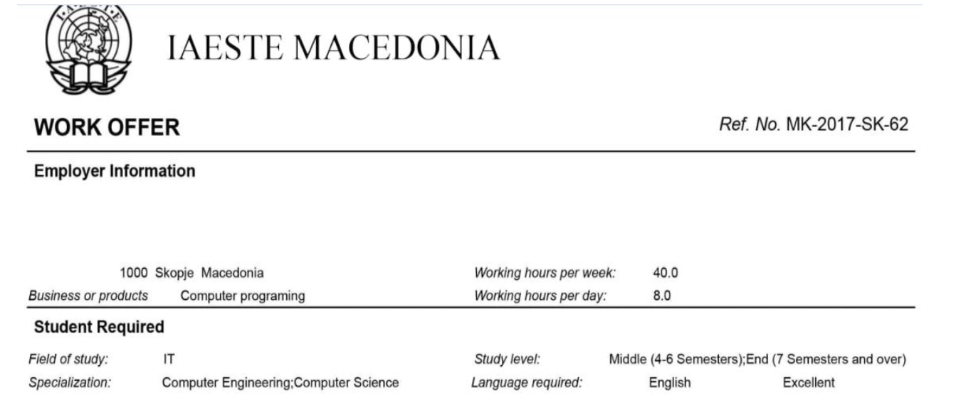
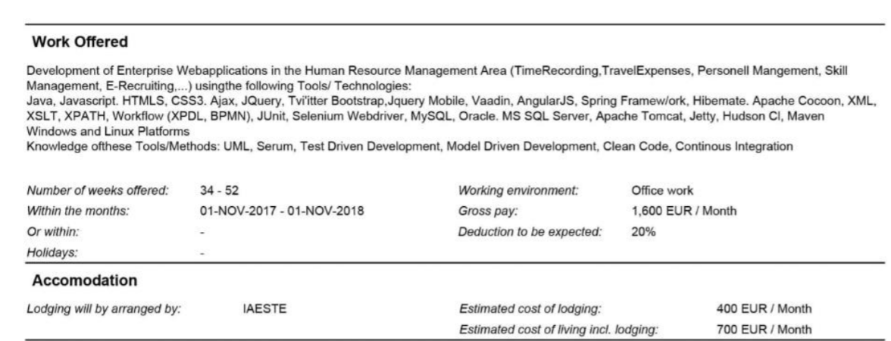
The O Form

Slide 25
The Exchange Sessions - Preparations
Raise placements/Create Opportunities.
Prepare Offer Forms
Send out Request of Offer Forms to other Members and Co-operating Institutions - “wish lists”
Prepare folders for each country with whom you wish to exchange

Slide 26
The IAESTE PAKISTAN
Pakistan became a member of IAESTE in 1990.
The National Secretary of IAESTE-PAKISTAN is Dr. S. A. Hassan, PNEC and the head office is located in Karachi.
More than 400 students have been offered internships worldwide. Pakistan has also hosted a lot of foreign students in different universities and companies.
IAESTE-Pakistan has three local committees.
IAESTE-KARACHI
IAESTE-ISLAMABAD
IAESTE-GIKI Campus

Slide 27
IAESTE PAKISTAN ORGANOGRAM
National Committee HQ (Karachi)
Local Committee
(Islamabad)
LOCAL COMMITTEE (ISLAMABAD)
Local Committee
(Karachi)
Chair
Principal SEECS, Dr. Arshad Ali
Exchange Coordinator
Ayesha Mushtaq
Student President
(in case of university chapter)
Outgoing Coordinator
Incoming Coordinator
IT Coordinator
Membership Coordinator
Marketing Coordinator
Any other univeristy Representatives
Vice Coordinator
Vice Coordinator
Vice Coordinator
Vice Coordinator
Vice Coordinator
The Local Committee’s tenure is defined as one year so as the make the maximum students to get benefited with the exposure of IAESTE.

Slide 28
ANNUAL CONFERENCE 2013-14

Slide 29
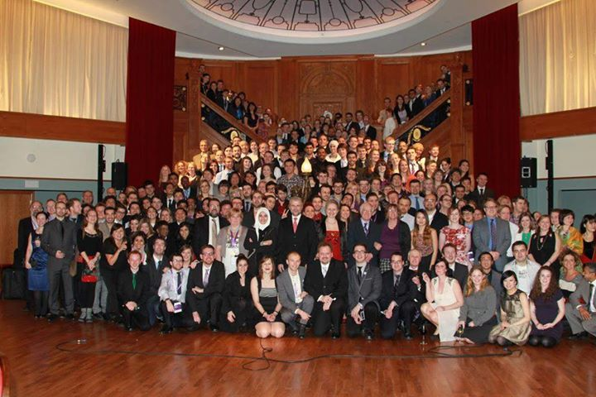

Slide 30
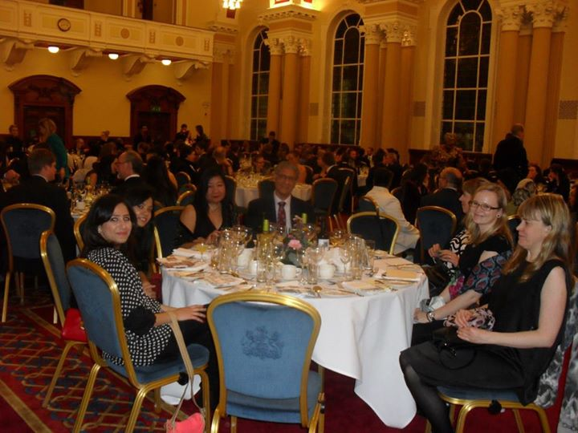

Slide 31
EXCHANGE SESSIONS

Slide 32
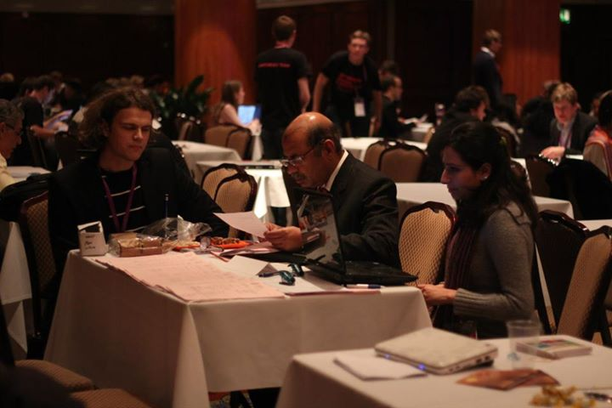
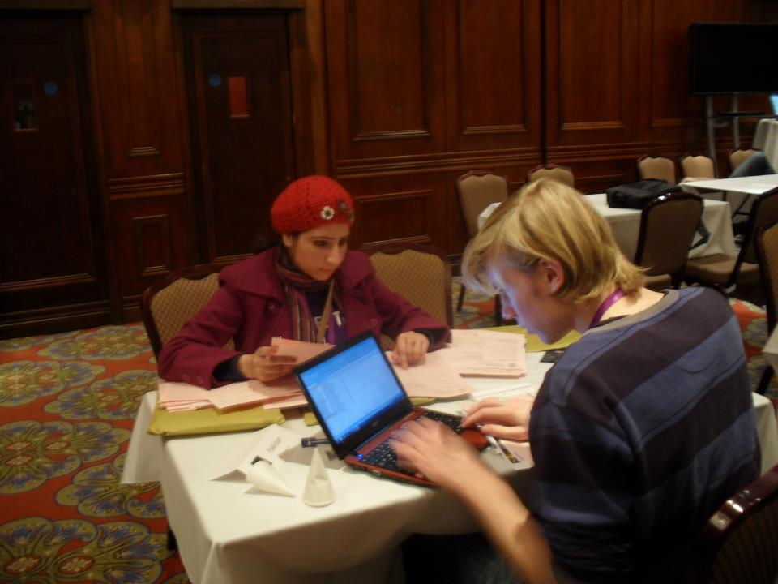

Slide 33
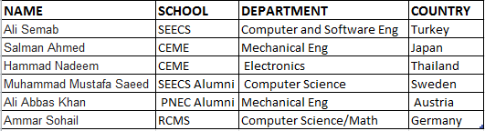
Outgoing Students for year 2013-14

Slide 34
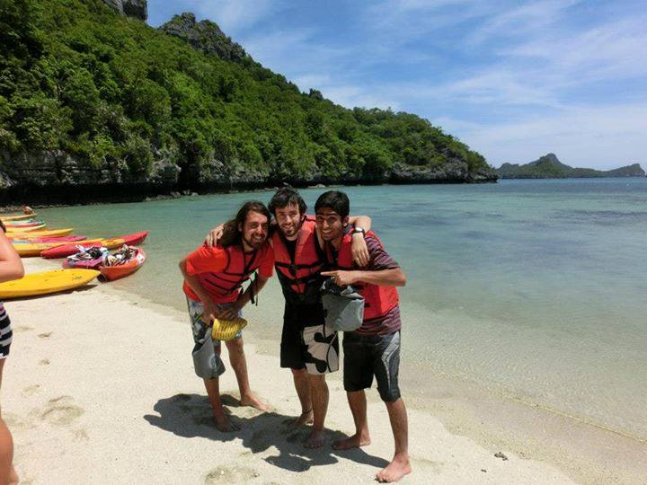
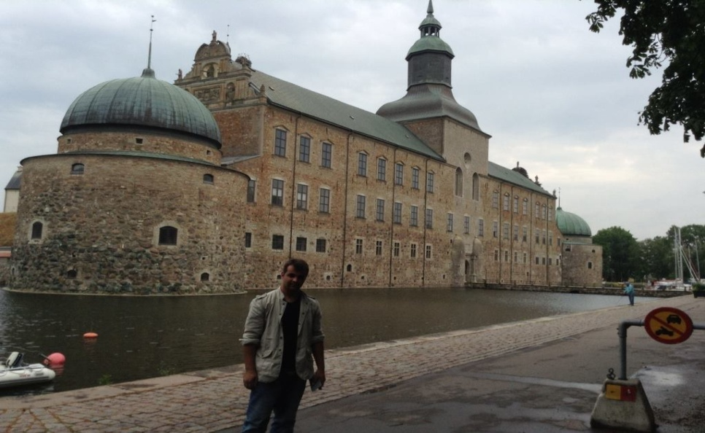
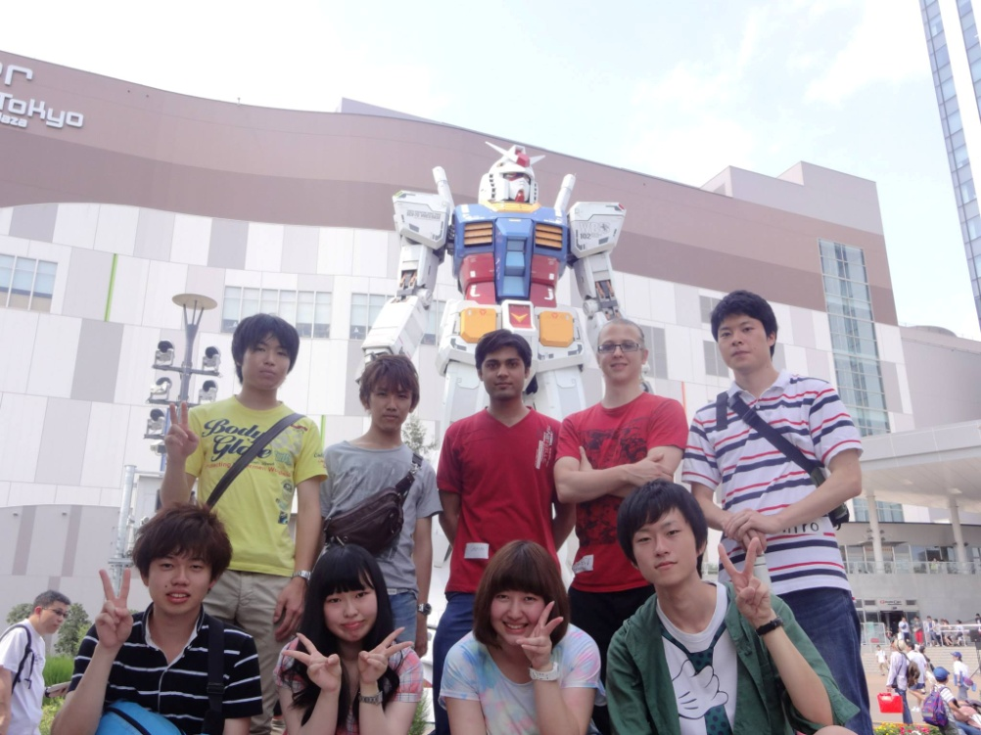
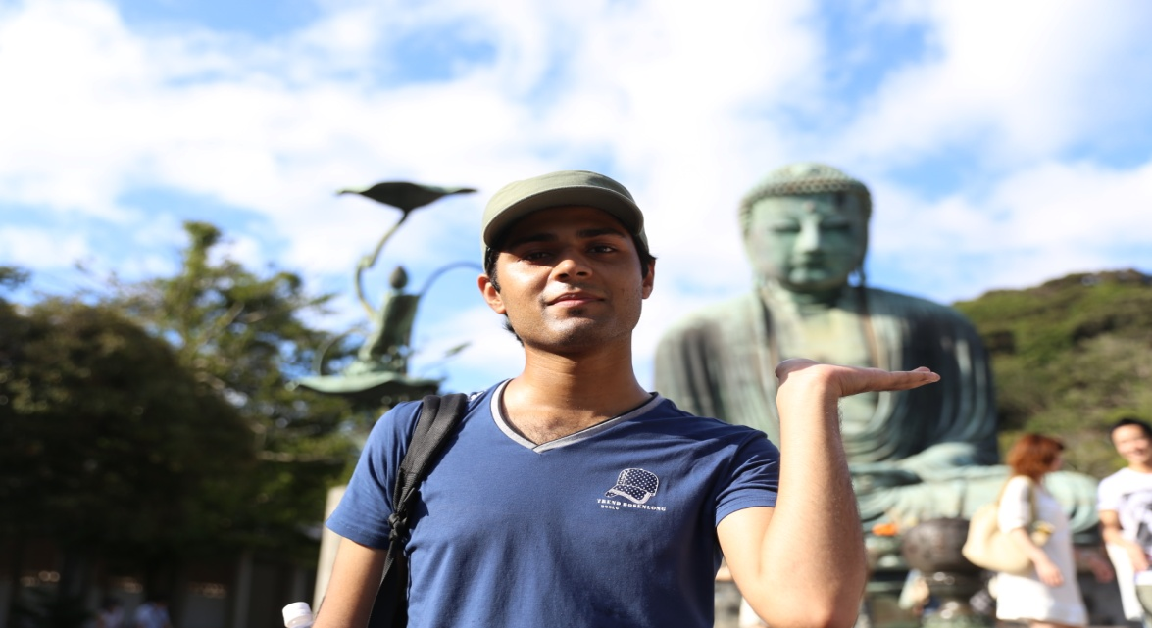
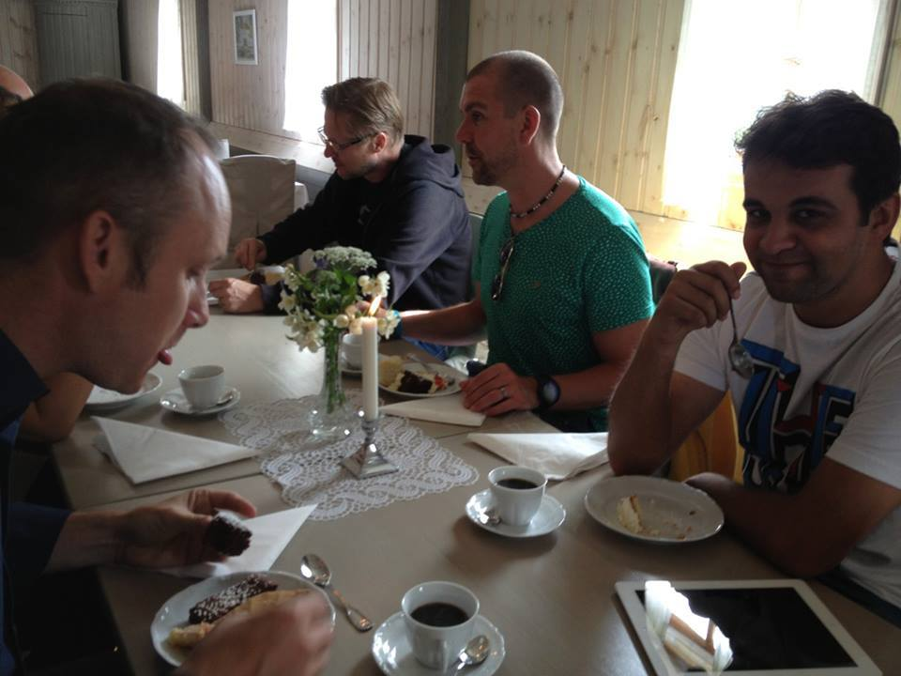
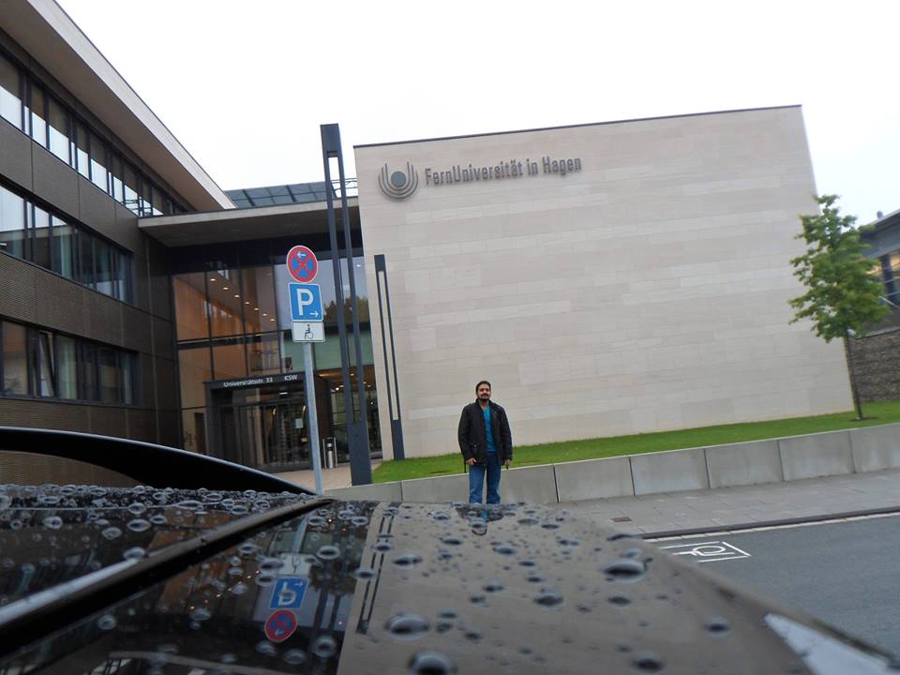
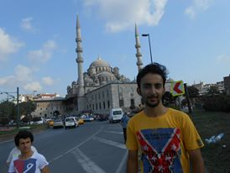
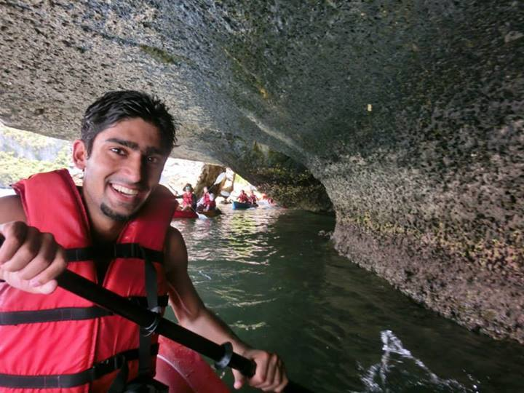

Slide 35
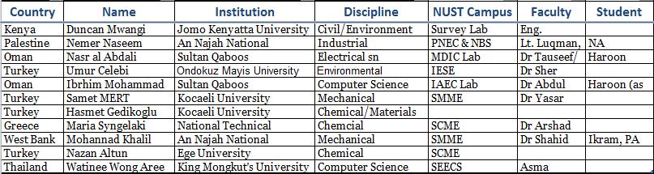
Incoming Students for year 2013-14

Slide 36
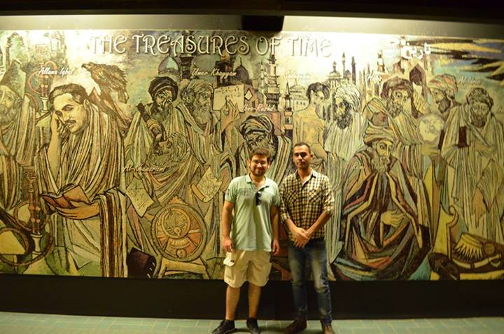
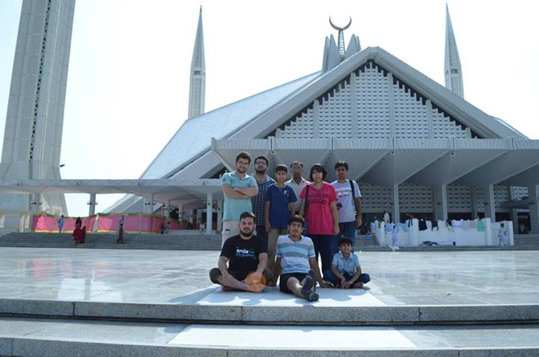
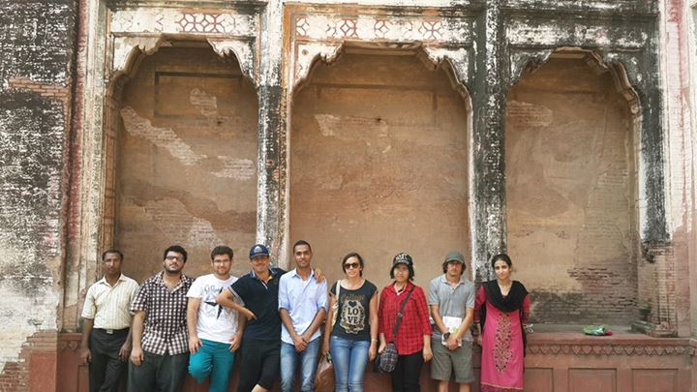
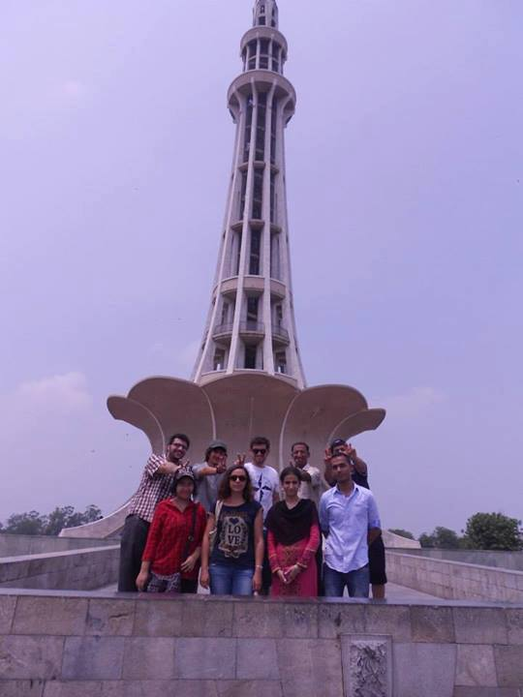
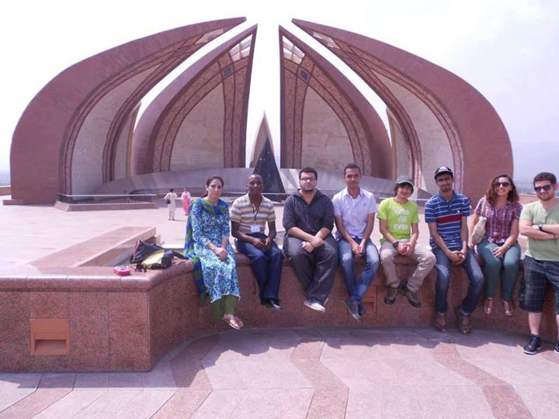
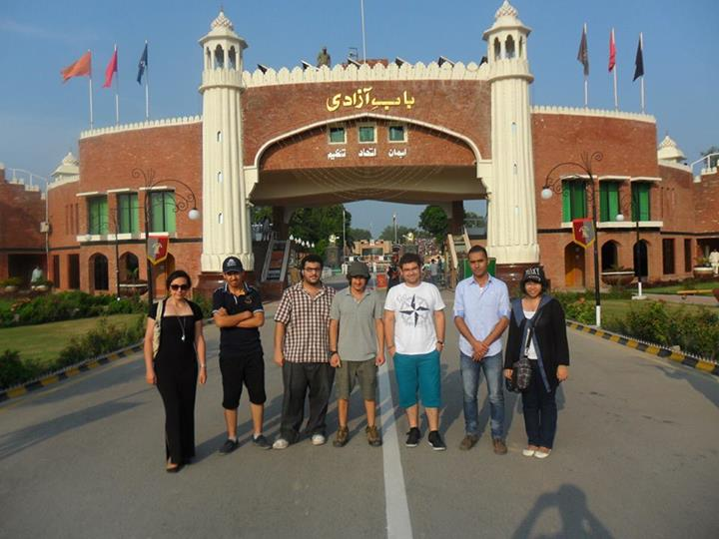
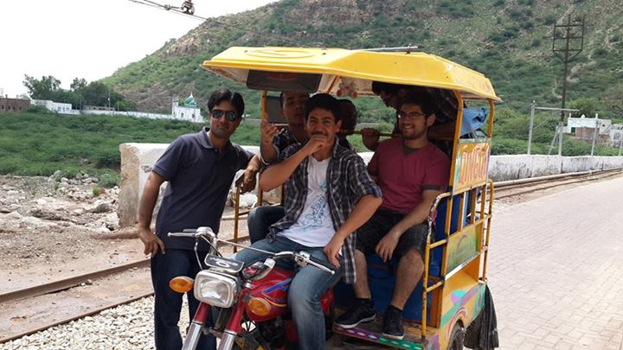
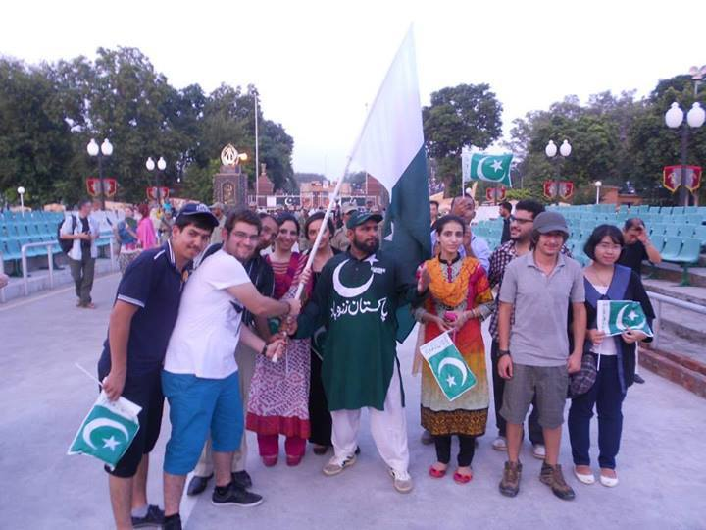
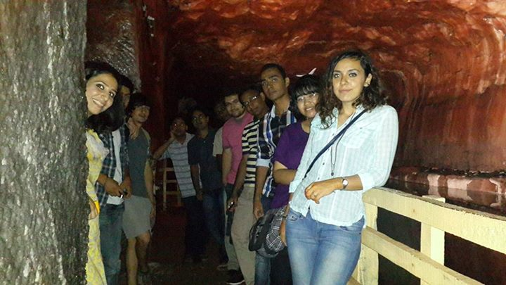
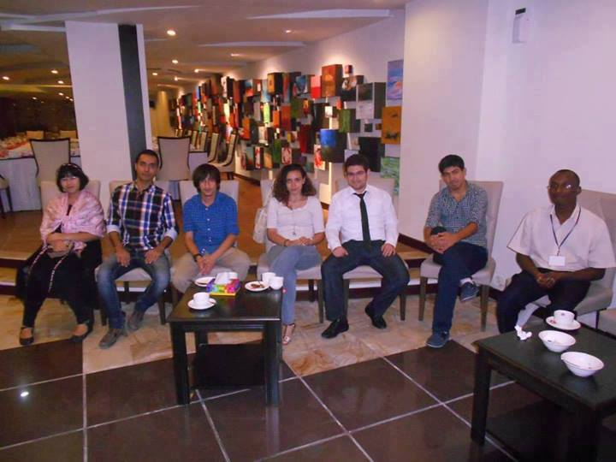

Slide 37
Guidelines for Students to avail Exchange Opportunities
Be an IAESTE Pakistan Member to avail the opportunities later
When offers are shared in February, select the ones you find yourself eligible/suitable for
Submit Complete Nomination to IAESTE Islamabad
Respond to the interview call
For selection updates stay connected to IAESTE Islamabad official website at or official facebook page at https://www.facebook.com/IAESTEIslamabad

Slide 38
Documents Required for a Complete Nomination
1. Application for nomination 2. Nomination Form 3. Language Certificate 4. Transcript/List of courses studied 5. Resume including a list of previous training/experience 6. Personal Statement 7. Recommendation Letter 8. Three passport size recent photographs 9. Photostat copy of your passport 10. Bank draft of Rs 15000 [Rs 5000 processing fee + Rs 10000 Security (refundable)] [Optional]

Slide 39
Other IAESTE Oppotunities
Besides, Internship Opportunities students can participate in the following IAESTE events as well
Seminar on IAESTE Development (SID)
Join Us to Motivate People (JUMP) Seminar
Annual Asian Forum Meeting
Annual Alumni Conference (AAC)

Slide 40
Perks for IAESTE members
IAESTE T-Shirt for every member
Discounts at Foreign Language Courses
Discounts on specific workshops and seminars
Members get precedence when internships are announced
Discounted recreational trips for members
Free Industrial trips
Full transport allowance for any IAESTE related conference or event held in Pakistan
Chance to interact and host Foreign Students
Annual Dinner

Slide 41
Taking part in IAESTE is fantastic way to:
Earn money and enhance your CV
Gain paid industry experience with top international employers
Develop your professional knowledge and contacts
Boost your confidence and communication skills
Explore a new country and culture

Slide 42
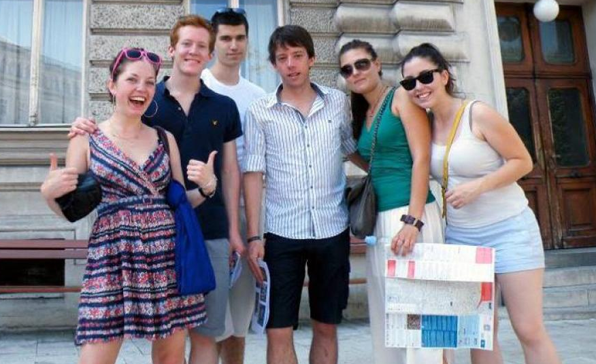
Testimonial
Emma Gayner did IAESTE work placement at Austria:
I learnt a lot from working in a university. It has given me a much better understanding of my future plans and what I want to do in life. I have formed strong friendships with people from all over the world, and I am now a board member of the IAESTE Local Committee which I am enjoying greatly.
My IAESTE internship was honestly, the best thing I have ever done and has changed my life!

Slide 43
IAESTE Annual Conference Offers
Country | Discipline | Reference Number | Duration (Weeks)
Croatia | Computer Science | HR-2017-1150 | 8
Iran | Chemical Engineering | IR-2017-1042 | 6 to 9
Oman | Mechanical Engineering | OM-2017-75 | 6 to 8
Panama | Environmental Engineering | PA-2017-PA-13FOR | 12 to 16
Poland | Electrical Engineering | PL-2017-PGD029 | 8
Serbia | Computer Science | RS-1132 | 8 to 12
Turkey | Software Engineering Information Technology Architecture Material Science | TR-2017-162-ODTU TR-2017-153-ODTU TR-2017-061-ITU TR-2017-024-EGE | 4 to 6 8 to 52 8 to 12 6 to 8
United Arab Emirates | Information Technology | AE-2017-U0S033 | 12
Vietnam | Economy and Management Electrical Engineering | VN-2017-VIU-03 VN-2017-VIU-02 | 12 8 to 12

Slide 44
IAESTE Experience

